Slide 1




Developing Questions and Designing the Questionaire

Slide 2

Agenda
Case 5 Discussion
Level of Measurement

Slide 3
What is coming up – busy two weeks
PA#4 Questionnaire design Due soon; signup sheet for peer team review and professor one-on-one review
Level of measurement quiz (individual)
Qualtrics homework (individual)

Slide 4
Steps to design questionnaire
Preparation:
Determine what information is needed (PA3)
Determine the method of administration
Write the questions:
Determine content of individual questions. (what kind of question)
Determine the form of response for each question (multiple choice, rating scale, etc.)
Determine the wording of each question and response
Organize the questionnaire:
Determine the sequence and number the questions
Appearance
Develop a recruiting message. Background of the survey, Does it attract respondents?
Evaluate
Evaluate the questions with respect to the research questions:
Qualifying - better respondent, Classifying, Answer RQ.
Add RQ. & enough to answer RQ?
Pretest : ask a few friends to answer the questionnaire and provide feedback such as the confusing question wordings and inappropriate response options.

Slide 5
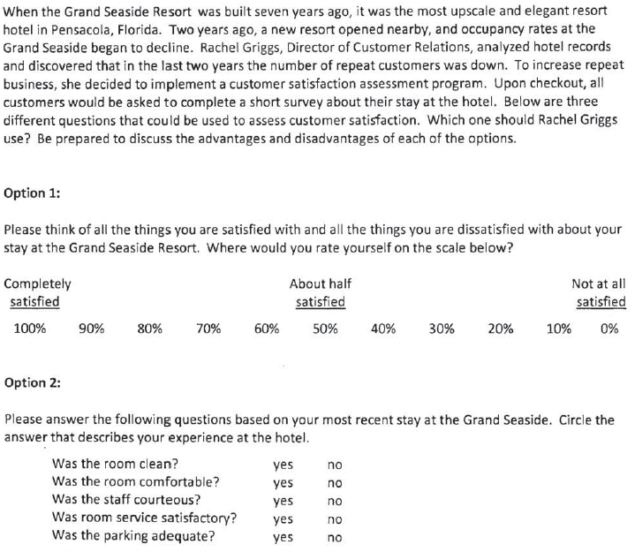
CE5

Slide 6
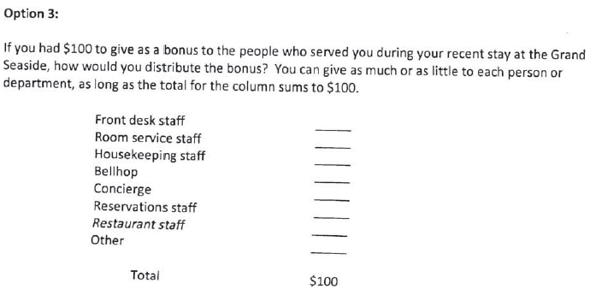
Option 3

Slide 7
Questions from other teams
Team 1 and 3: Which one of these surveys do you think would have the highest response rate if they were optional? Do you personally prefer to write down how their service was or circle/mark a scale from completely satisfied to unsatisfied?
Team 2: From option 2, how would be able to get specific research if people were in between on “Yes” or “No”?
Team 7: Which option would be the best way to see customer satisfaction? Is there another way you would use to rate customer satisfaction?
Notes:
Team1:
1. Would it be effective for Rachel to use more than one of the survey questions?2. Which one of these surveys do you think would have the highest response rate if they were optional?
T2: Address it.
From option 2, how would be able to get specific research if people were in between on “Yes” or “No”? Would the results be skewed since they are only given two option instead of multiple options to answer the questions?
T3:
1. What form of survey would you consider more cost effective and produce the best results?2. Do you personally prefer to write down how their service was or circle/mark a scale from completely satisfied to unsatisfied?
T6:
1. For Option 2, are the questions too specific? How were these specific questions selected?2. For Option 3, could there be an option to explain why a high or low tip was given?
T7:
Why do you think the option you chose would be the best way to see customer satisfaction?Is there another way you would use to rate customer satisfaction?

Slide 8
Data Collection Method
Surveys
Understand two critical aspects of surveys
How to design the questionnaire
Questions
Reponses
Notes:
In today’s class we will focus on response formats

Slide 9
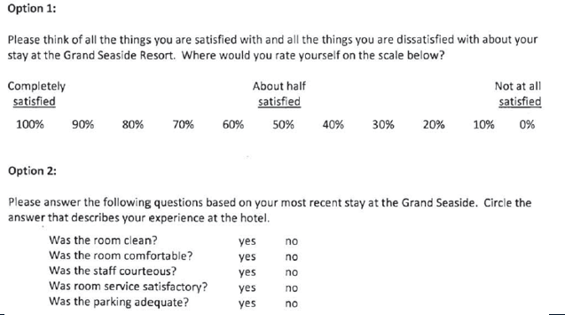
What is a Response Format
Response Format help you capture the response in the desired format

Slide 10

What is Measurement?
Measurement is determining how much of a property is possessed by the entity you are measuring. Entity in our case can be customer, brands, stores, advertisements etc.
Measurement vs. the variable?
Notes:
measurement is amount of information within a variable.
For example, gender. how much detail? to what extend you consider yourself as a female?

